Slide 1
Predicting a Buyer
[ DAT-NYC-45 ]

Slide 2


Agenda
Problem Statement & Background
Data Source and Features
Exploratory Data Analysis
Model Insights
Inference
THE AGILE AUDIENCE ENGINE

Slide 3

Fluent is a performance-based customer acquisition platform
While the company excels at customer acquisition, it must improve at selling merchandise.
Problem statement: using user demographic data from July-August 2016, predict whether a user visiting a Fluent site will buy an item

Slide 4
Background
The placement of the CPA Wall fluctuates depending on the user
Generally e-commerce/retail sites have a ~3% conversion rate
Given that there will be user attrition throughout our site, a purchase rate of 1.5% (based on the data set), for all registered users, is not awful

Slide 5
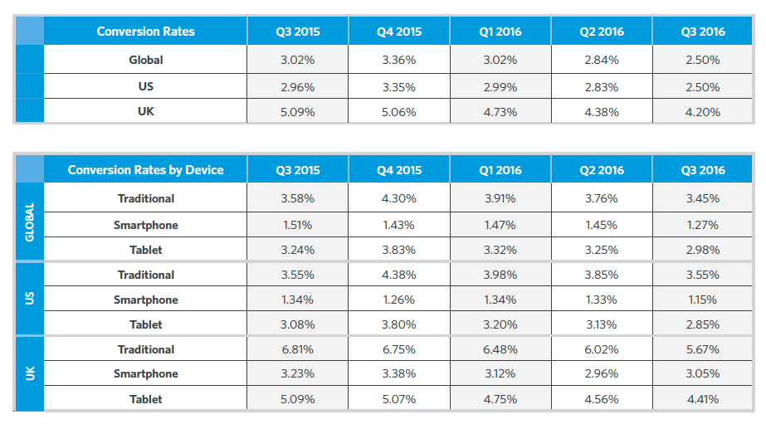
Background
Fluent user-base is from the U.S. and is usually on his or her mobile device
(chart from Smart Insights)

Slide 6
Hypothesis
Buyer profile:
Female
> 45 years old.
Age will have the most impact
an older person typically tends to have more disposable income
Random Forest model will work best on this dataset
Since 1.5% of users in dataset are buyers, model must beat 98.5% dummy model accuracy score

Slide 7
Agenda
Problem Statement & Background
Data Source and Features
Exploratory Data Analysis
Model Insights
Inference
THE AGILE AUDIENCE ENGINE

Slide 8
Dataset
60K observations
11 features; 9 categorical
Classifying a buyer:
1 (Buyer)
0 (Not a buyer)
Transformations
Grouped ESPs, created esp_group feature
Grouped states, created region feature
Features include:
Age
Gender
State
ESP (email service provider)
vag
val
vas
vaq
v2m
CPAWallBuyer
count(0)

Slide 9
Agenda
Problem Statement & Background
Data Source and Features
Exploratory Data Analysis
Model Insight
Inference
THE AGILE AUDIENCE ENGINE

Slide 10
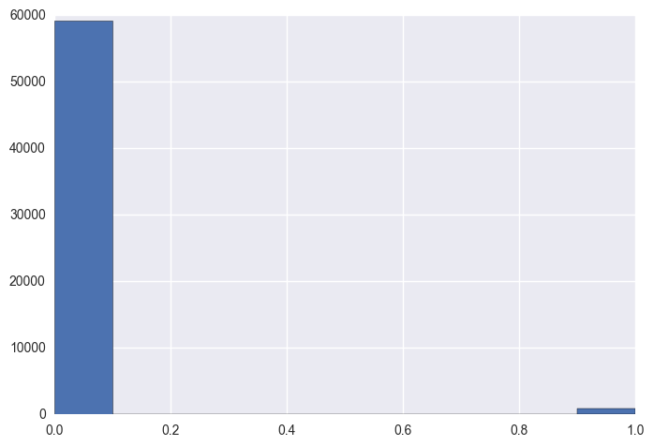
Outcome/Dependent Variable: Buyer
Imbalanced dataset; buyer class 1.5% of total

Slide 11
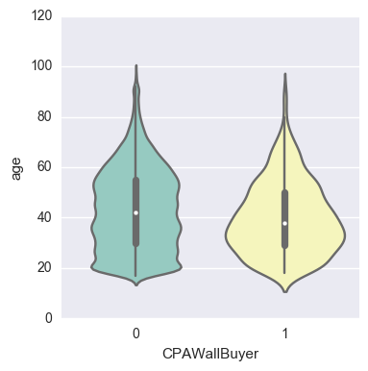
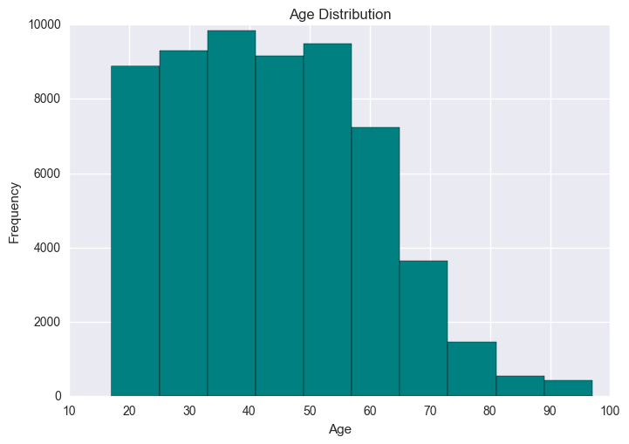
Age Feature
Large number of buyers seem to be within 20-40 age range

Slide 12
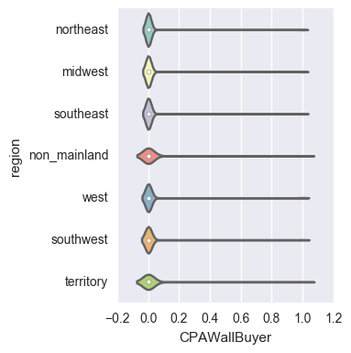
Region Feature

Slide 13
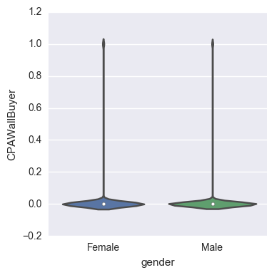
Gender Feature

Slide 14
Agenda
Problem Statement & Background
Data Source and Features
Exploratory Data Analysis
Model Insights
Inference
THE AGILE AUDIENCE ENGINE

Slide 15
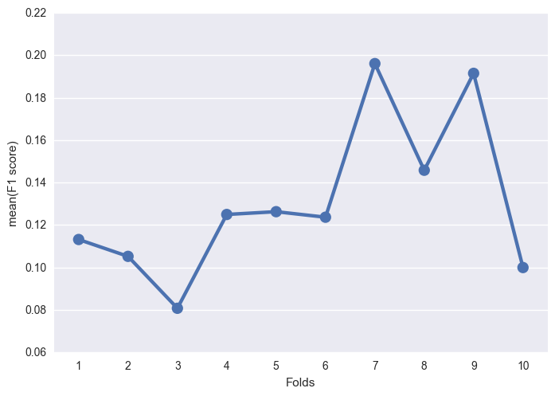
Random Forest: F1 Scores
Training data set mean F1 score= ~0.13

Slide 16
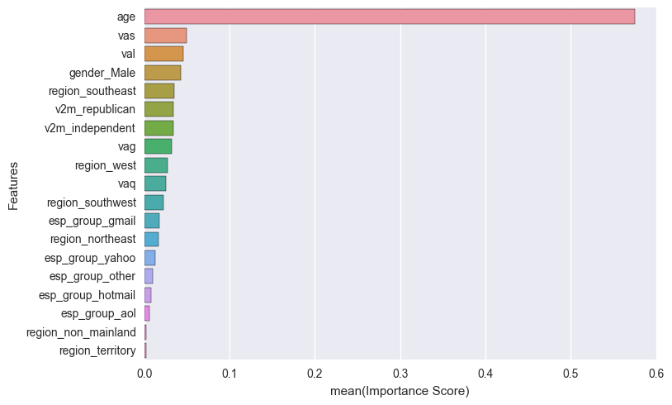
Random Forest: Feature Importance

Slide 17
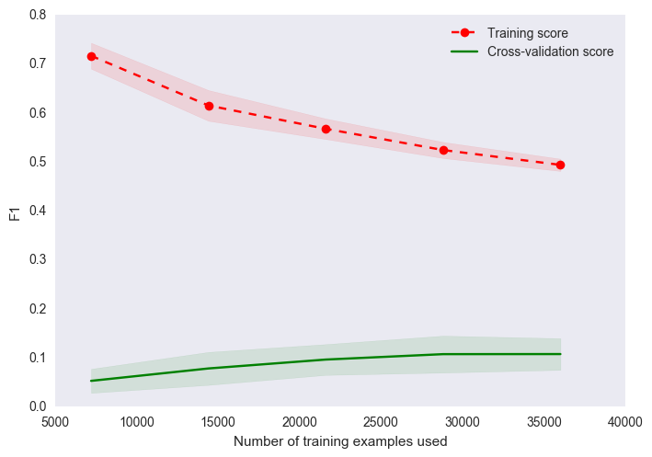
Random Forest: Learning Curve
High bias; noise in the data; need better features

Slide 18
Agenda
Problem Statement & Background
Data Source and Features
Exploratory Data Analysis
Model Insights
Inference
THE AGILE AUDIENCE ENGINE

Slide 19
Inference
Accuracy score on the test data set ~98.5%.
DID NOT BEAT DUMMY MODEL!
Truly need to obtain better features to eliminate HIGH BIAS, and underfitting.

Slide 20
Next Steps
Using users’ zip code, will use U.S. Census data to acquire Median Household Income of zip code where user resides
Add employment status to dataset
Add media channel to dataset; what channel user entered a Fluent site (social, display, etc.)

Slide 21
Thank You

